Slide 1
Transfer Learning and Transformers
Andrei Manolache
amanolache@bitdefender.com
Special thanks to Florin Brad for the slides

Slide 2
Outline
Static Word Embeddings:
tokenization (aka how to split text)
word embeddings (aka how to represent words with vectors)
word2vec (aka how to compute such vectors)
transfer learning with word2vec
Contextual Word Embeddings:
the Transformer
BERT

Slide 3
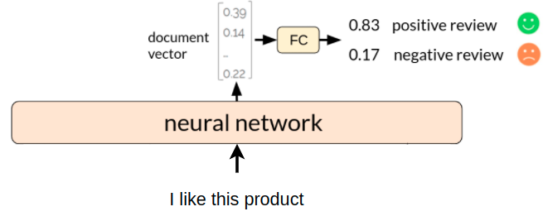
NN for text classification

Slide 4
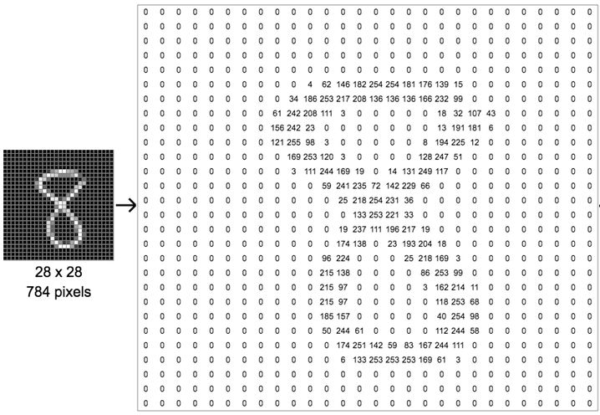
Numerical representation
we know how to represent an image with numbers

Slide 5
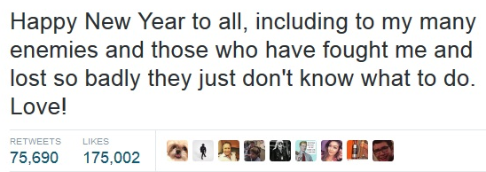

Numerical representation
we know how to represent an image with numbers
but how do we represent a text with numbers?

Slide 6
First, how do we split text?
split into characters
‘H’, ‘a’, ‘p’, ‘p’, ‘y’, ‘ ‘, ‘N’, ‘e’, ‘w’, ‘ ‘, ‘Y’, .... , ‘L’, ‘o’, ‘v’, ‘e’, ‘!’

Slide 7
First, how do we split text?
split into characters
‘H’, ‘a’, ‘p’, ‘p’, ‘y’, ‘ ‘, ‘N’, ‘e’, ‘w’, ‘ ‘, ‘Y’, .... , ‘L’, ‘o’, ‘v’, ‘e’, ‘!’
split into words
‘Happy’, ‘New’, ‘Year’, ‘to’, ‘all’, ‘,’, ‘including’, ..., ‘Love’, ‘!’

Slide 8
First, how do we split text?
split into characters
‘H’, ‘a’, ‘p’, ‘p’, ‘y’, ‘ ‘, ‘N’, ‘e’, ‘w’, ‘ ‘, ‘Y’, .... , ‘L’, ‘o’, ‘v’, ‘e’, ‘!’
split into words
‘Happy’, ‘New’, ‘Year’, ‘to’, ‘all’, ‘,’, ‘including’, ..., ‘Love’, ‘!’
split into wordpieces
‘Happy’, ‘New’, ‘Year’, ‘to’, ‘all’, ‘,’, ‘includ’, ‘##ing’, ..., ‘Love’, ‘!’

Slide 9

Tokenization
process by which we split text into smaller units, called tokens
tokens can correspond to linguistic words (‘hello’), but it’s not always the case (‘nlp2018’)
hello, my, name, is, Anne, and, I, write, …
https, www, mit, com, class, nlp2018, assignments, hw1, pdf

Slide 10
Say we split text into words, how do we encode them?
tokenize text
‘Happy’, ‘New’, ‘Year’, ‘to’, ‘all’, ‘,’, ‘including’, ..., ‘Love’, ‘!’
encode
words
‘Happy’ = ?
‘New’ = ?
…
‘!’ = ?

Slide 11
One-hot representation for words
…
car = [0 0 0 0 0 1 0 0 0 0 0 0 0 0 0 0 0 0 0 0 0 … ]
vocabulary …
bus = [0 0 0 0 0 0 0 0 0 0 0 0 0 0 1 0 0 0 0 0 0 … ]
....
simplest representation (makes no assumptions)
vectors are orthogonal (don’t capture similarity)
size = number of words in vocabulary

Slide 12
Dense representation for words (embeddings)
…
car = [0.12 0.17 0.93 … 0.10 0.98]
vocabulary …
bus = [0.64 0.07 0.86 … 0.23 0.56]
....
each word is represented by a dense feature vector
these vectors are not handcrafted, but learned by a network
size ∈ [50, 1000]

Slide 13
Dense representation for words
‘vehicleness’
…
car = [0.12 0.17 0.93 … 0.10 0.98]
vocabulary cat = [0.41 0.15 0.17 … 0.81 0.20]
bus = [0.64 0.07 0.86 … 0.23 0.56]
....
dimensions could encode different properties (not always interpretable)
size ∈ [50, 1000]

Slide 14
Dense representation for words
‘vehicleness’
‘animal’
…
car = [0.12 0.17 0.93 … 0.10 0.98]
vocabulary cat = [0.41 0.15 0.17 … 0.81 0.20]
bus = [0.64 0.07 0.86 … 0.23 0.56]
....
dimensions could encode different properties (not always interpretable)
size ∈ [50, 1000]

Slide 15
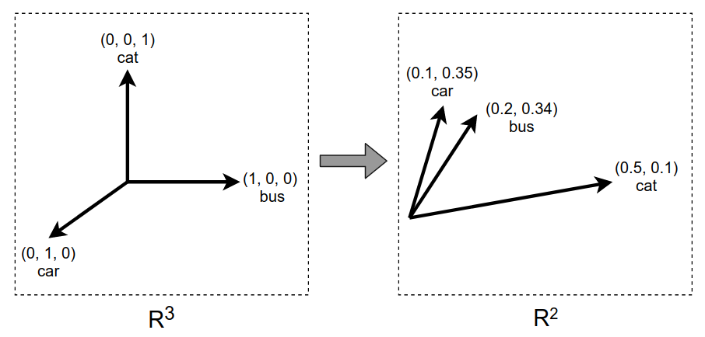
One-hot vs dense vectors
one-hot vectors:
words are equally distant in vector space
dense vectors (embeddings):
similar words have similar vectors
vs

Slide 16
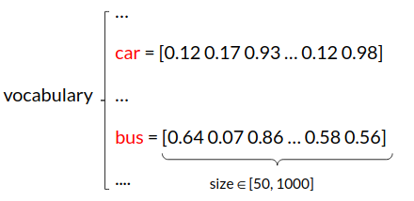
Having word vectors is nice, but how do we obtain them?

Slide 17
Having word vectors is nice, but how do we obtain them?
the word vectors are just parameters that the network will adjust during training

Slide 18
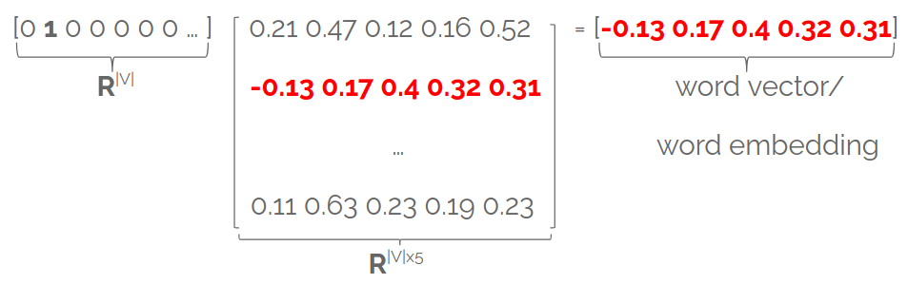
Embedding layer
stores word embeddings in a matrix E∈^{|V| x d}
each row in E is a word embedding associated with a given word
matrix E is fully learnable!
you can think of it as a fully-connected layer applied to one-hot vectors

Slide 19

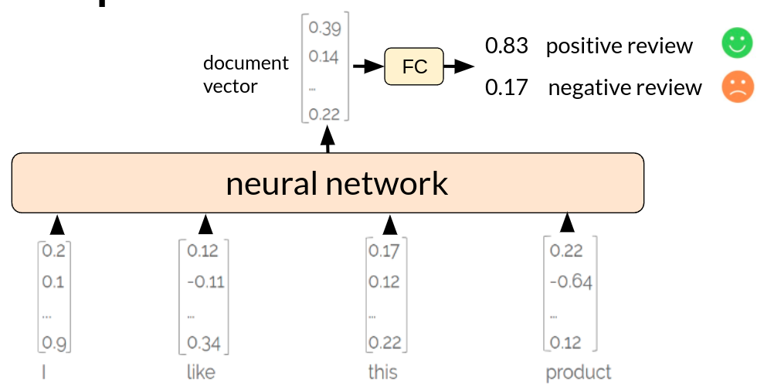
NN for text classification
Model learns word embeddings/features and how to combine these features for classification
neural network layers
word embedding layer
(randomly initialized)
students
...

Slide 20
NN for text classification
Model learns word embeddings/features and how to combine these features for classification
neural network layers
word embedding layer
students
...
What if we don’t want to learn word features from scratch?

Slide 21
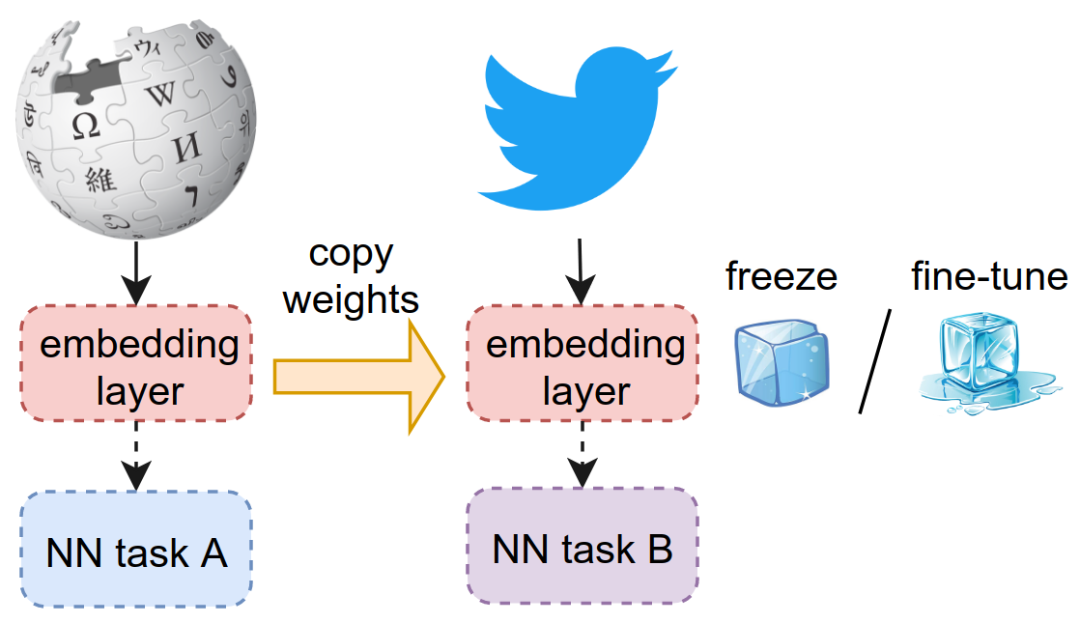
word2vec (Mikolov et al 2013)
Algorithm that learns general-purpose word vectors from lots of text
transfer learning: these word vectors can be used to initialize the embedding layer of another network

Slide 22
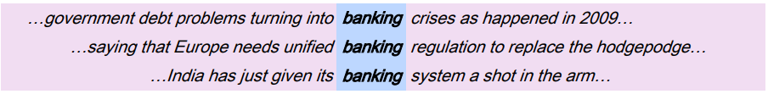
Find word based on its context
the same word is missing from each sentence
adapted from Stanford Deep Learning Course, Lecture 1 http://web.stanford.edu/class/cs224n/slides/cs224n-2019-lecture01-wordvecs1.pdf

Slide 23
Meaning is context
a word’s meaning is given by the words nearby (context)
idea: use the many contexts in which ‘banking’ appears in order to build a word vector for ‘banking’
from Stanford Deep Learning Course, Lecture 1 http://web.stanford.edu/class/cs224n/slides/cs224n-2019-lecture01-wordvecs1.pdf

Slide 24
word2vec (skip-gram) idea
A simple classifier that learns word vectors from lots of text (Wikipedia)
Binary classification task: is word c a real context word for target word t?
drive many miles by car

Slide 25
word2vec (skip-gram) idea
A simple classifier that learns word vectors from lots of text (Wikipedia)
Binary classification task: is word c a real context word for target word t?
drive many miles by car
Classifier predicts:
high probability for likely (context, target) pairs:
P(context=real | c = drive, t = miles) = 0.86
P(context=real | c = car, t = miles) = 0.73
low probability for unlikely (context, target) pairs:
P(context=real | c = tomato, t = miles) = 0.13

Slide 26
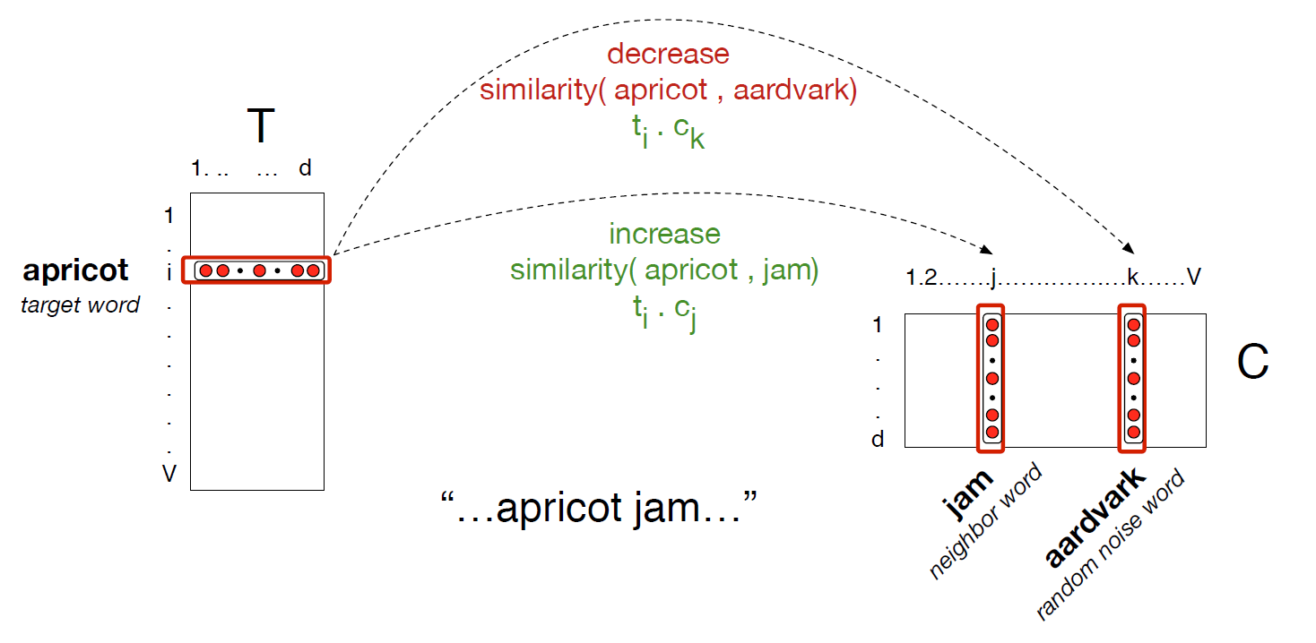
Shift embeddings during training
from Speech and Language Processing 3rd edition, Manning and Jurafsky

Slide 27
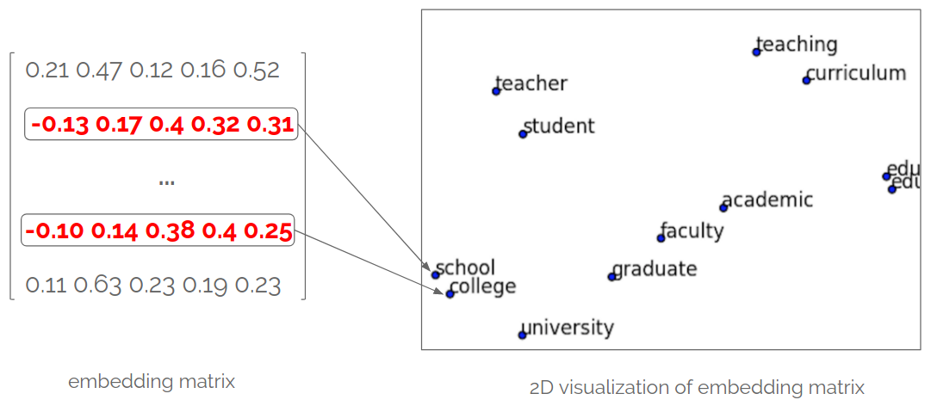
Word embeddings after training
number_of_words x 300

Slide 28
NN for text classification
Model ‘knows’ how to represent the words and only has to learn how to classify the text
neural network layers
word embedding layer
students
...
initialized with pretrained word embeddings such as word2vec, FastText etc.

Slide 29
Checkpoint
Tokenization
split text into smaller parts, called tokens
Word embeddings/word vectors
semantically-aware vectors (similar words have similar vectors)
Word2vec (negative sampling skip-gram)
algorithms that obtain general-purpose word embeddings
trains binary classifier to distinguish real (word, context) pairs from fake ones
vectors of similar words are pushed to space where they have high similarity
Transfer learning
initialize word embedding layer on a new task with pre-trained word embeddings: word2vec, Glove, fastText, etc.

Slide 30
NN for text classification
How does this network look like? Could we aggregate the word embeddings without a neural network?
neural network layers
word embedding layer
students
...

Slide 31
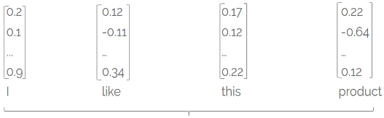
Bag of word embeddings
document vector = average/sum of word vectors
+
+
+

Slide 32
NN for text classification
Train MLP over bag of word embeddings
FC layers
word embedding layer
students
...
average/sum

Slide 33
Bag of word embeddings - drawbacks
document vector = average/sum of word vectors
+
+
+
however, order is discarded:
the movie wasn’t bad, it was actually quite good
the movie wasn’t good, it was actually quite bad

Slide 34
Bag of word embeddings - drawbacks
document vector = average/sum of word vectors
+
+
+
different meanings, same document vector
however, order is discarded:
the movie wasn’t bad, it was actually quite good
the movie wasn’t good, it was actually quite bad

Slide 35



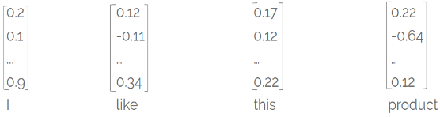
NN for text classification
0.83 positive review
0.17 negative review
we need a more complex model that:
aggregates word vectors
takes word order into consideration
document vector
FC
neural network

Slide 36
Static word embeddings drawbacks
Sensitive to small differences: apple vs apples
Cannot handle polysemy (go home vs let’s play go):
this is why they are also called static embeddings or context-free embeddings
Cannot represent out-of-vocabulary words (fantastik)
but can be enriched with subword information (character n-grams) (Bojanowski et. al 2017)

Slide 37
Outline
Static Word Embeddings:
tokenization (aka how to split text)
word embeddings (aka how to represent words with vectors)
word2vec (aka how to compute such vectors)
transfer learning with word2vec (sentence classification with RNN and CNN)
Contextual Word Embeddings:
the Transformer
BERT

Slide 38
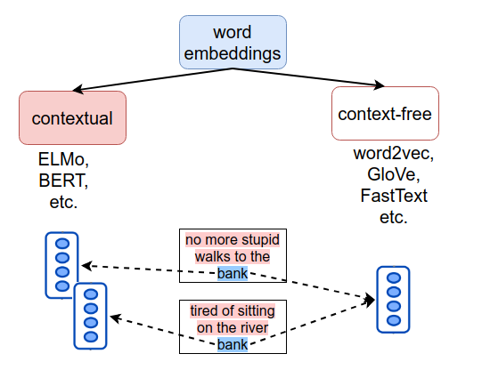
Word embedding types
context-free: each word has a single, static embedding, regardless of the word’s context
contextual: each word has different embeddings, depending on the word’s context

Slide 39
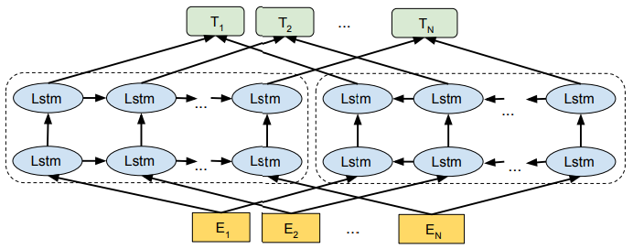

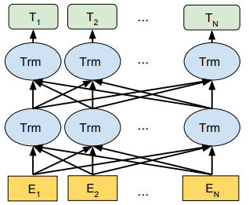
Recipe for contextual word embeddings
architectures
self-supervised tasks
lots of data
Predict future from past:
I wonder what to say ____
Fill-in-the-blank:
I feel like ____ is missing
based on recurrent networks (ELMo)
based on Transformer (BERT)

Slide 40
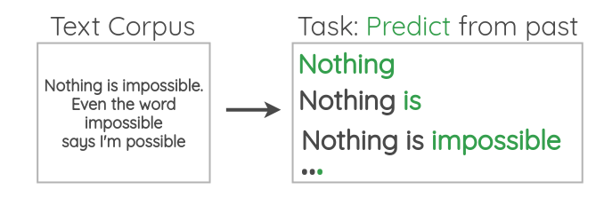
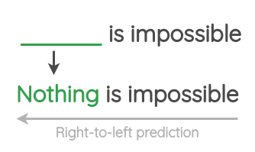
Language Model
task: predict the next word, given the previous ones
reverse task: predict past from future

Slide 41
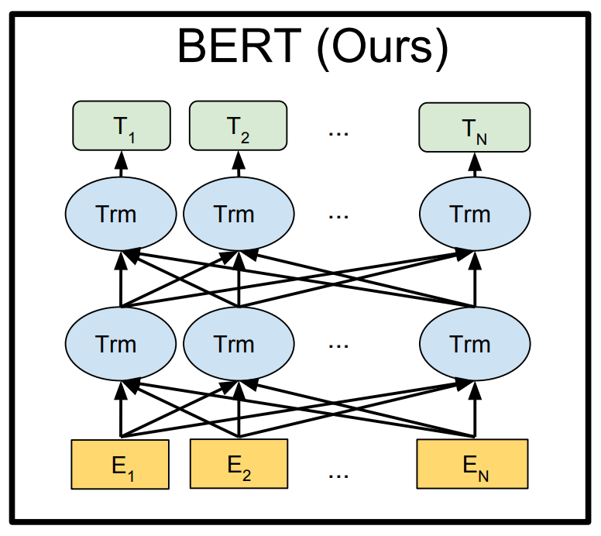
Modern transfer learning in NLP
transfer pre-trained deep models, which:
are based on the Transformer block
are trained with self-supervised tasks
encode deep contextual embeddings
fine-tuning these models leads to large improvements in downstream tasks
depth = 24 blocks

Slide 42
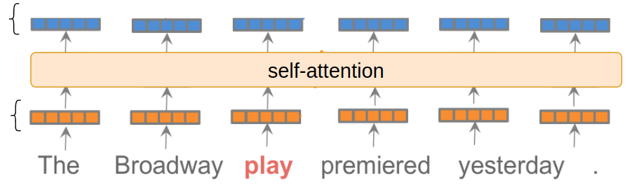
Self-attention blackbox
maps N input vectors x⁽¹⁾, x⁽²⁾, …, x^{(N)} to N output vectors y⁽¹⁾, y⁽²⁾, …, y^{(N)}
each output vector y^{(i)} incorporates context from all input vectors x⁽¹⁾, x⁽²⁾, …, x^{(N)}
knows about ‘The’, ‘Broadway’, ‘premiered’ and ‘yesterday’
contextual word embeddings
word embeddings

Slide 43
Self-attention blackbox
idea: every word ‘looks’ at all the input words (including itself)
the most ‘compatible’ ones contribute the most to the output
0.1*The + 0.2*Broadway + 0.2*play + 0.4*premiered + 0.1*yesterday
0.1*The + 0.1*Broadway + 0.1*play + 0.3*premiered + 0.4*yesterday
contextual word embeddings
word embeddings

Slide 44
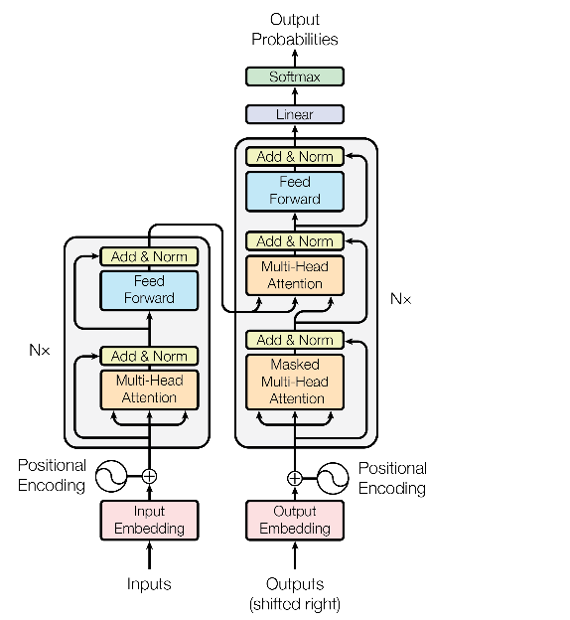
Self-attention issue
self-attention has no ‘positional awareness’
cat sat on the mat
mat sat on the cat
solution: add positional encoding

Slide 45
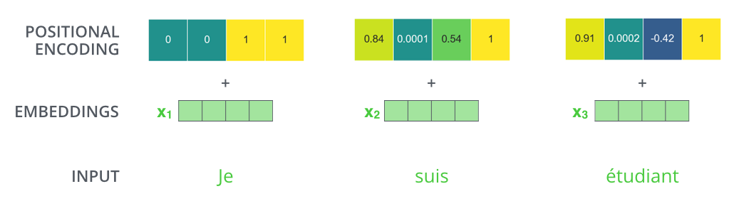
Positional Encoding
add position-aware encodings to the word embeddings so that order matters
these encodings are either:
fixed and precomputed (no learned parameters)
learned embeddings
figure from http://jalammar.github.io/illustrated-transformer/
Notes:
For an in-depth explanation of the original fixed positional encoding (used in ‘Attention is all you need’), see this resource: https://kazemnejad.com/blog/transformer_architecture_positional_encoding/

Slide 46
Transformer block
multi-head self-attention is part of Transformer block

Slide 47
Transformer block
multi-head self-attention is part of Transformer block
other key ingredients:
residual connections
layer normalization

Slide 48
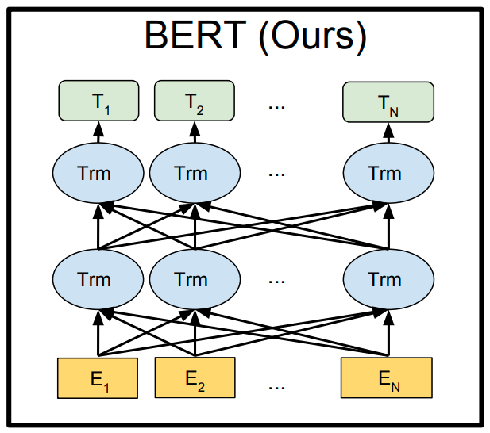
BERT (Bidirectional Encoder Representations from Transformers)
network produces deep contextual word embeddings using 24 stacked Transformer blocks
fine-tuning BERT results in state-of-the-art on 11 NLP tasks

Slide 49
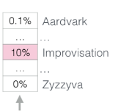
BERT training task 1
Masked Language Modeling (MLM): mask 15% of input words and then predict them
output vectors T_{i} incorporate bidirectional context (unlike LM task)
...
...
T₁
T₂
T₅
T₅₁₂
BERT
figure from http://jalammar.github.io/illustrated-bert/
Notes:
BERT naturally incorporates bidirectional context, via the MLM task and bidirectionality of self-attention.

Slide 50

BERT training task 2
Next sentence prediction (NSP): given two sentences A and B, does B follow A?
subsequent papers (RoBERTa - Facebook) showed NSP objective can be removed
figure from http://web.stanford.edu/class/cs224n/slides/Jacob_Devlin_BERT.pdf

Slide 51
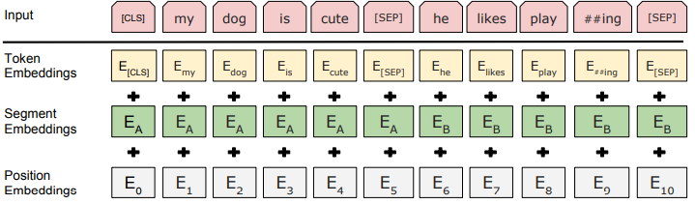
Input representation
add token, segment and position embeddings
special tokens:
[CLS] beginning of sequence

Slide 52
Input representation
add token, segment and position embeddings
special tokens:
[CLS] beginning of sequence
[SEP] separates two sentences/segments

Slide 53
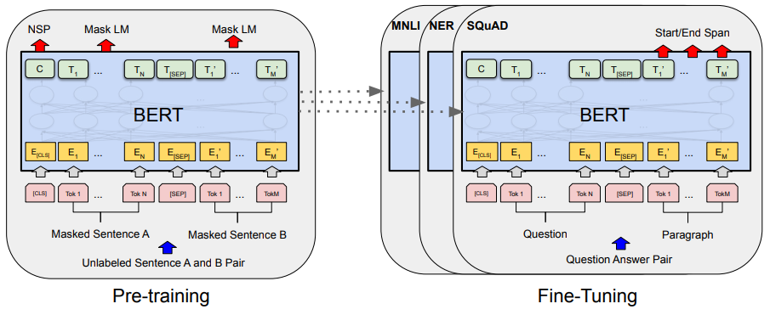
Training data
pre-trained on Wikipedia (2.5B words) + BookCorpus (800M words)
fine-tuned on classification tasks

Slide 54

BERT research directions
ALBERT
DistillBERT
BioBERT
SciBERT
smaller models
domain adaptation
language specific
vision and language representations
French: CamemBERT
Italian: AlBERTo
VideoBERT
VilBERT

Slide 55
Resources for NLP with NNs
Textbooks:
A Primer on Neural Network Models for Natural Language Processing, Yoav Goldberg
Natural Language Understanding with Distributed Representation, Kyunghyun Cho
Speech and Language Processing 3rd edition, Dan Jurafsky and James H. Martin
Courses:
Stanford Deep Learning for NLP: http://web.stanford.edu/class/cs224n/
CMU Neural Networks for NLP: http://www.phontron.com/class/nn4nlp2020/

Slide 56
References
Word embedding papers:
Efficient Estimation of Word Representations in Vector Space, Mikolov et. al 2013
Contextual word embeddings papers:
ELMo: Deep contextualized word representations, Peters et al. 2018
Transformer: Attention is all you need, Vaswani et al. 2017
GPT: Improving Language Understanding by Generative Pre-Training, Radford et al. 2018
BERT: Pre-training of Deep Bidirectional Transformers for Language Understanding, Devlin et al. 2018

Slide 57
References (2)
Presentations:
Deep Learning Meetup March 2020: slides
Blogs:
https://jalammar.github.io/illustrated-transformer/
https://jalammar.github.io/illustrated-bert/
https://ruder.io/nlp-imagenet/

